Slide 1


Understanding Computers
15th Edition
Today and Tomorrow
Comprehensive
Chapter 4
Input and Output
Deborah Morley Charles S. Parker
Copyright 2015 Cengage Learning

Slide 2
Learning Objectives
Explain the purpose of a computer keyboard and the types of keyboards widely used today.
List several different pointing devices and describe their
functions.
Describe the purposes of scanners and readers and list some
types of scanners and readers in use today.
Explain what digital cameras are and how they are used today.
Understand the devices that can be used for audio input.

Slide 3
Learning Objectives
Describe the characteristics of a display device and explain some of the technologies used to display images.
List several types of printers and explain their functions.
Identify the hardware devices typically used for audio output.

Slide 4
Overview
This chapter covers:
  The most common input devices
  Hardware designed for capturing data in electronic form
  Audio input
  Types of display devices and how they work
  Types of printers and how they work
  Audio output devices

Slide 5
Keyboards
An input device used to enter characters at the location marked by the insertion point or cursor
  Can be wired or wireless
  Typically contains:
    Standard alphanumeric keys
    Numeric keypad
    Function keys
    Delete and Backspace keys
    Control and Alternate keys
    Arrow directional keys and special keys

Slide 6
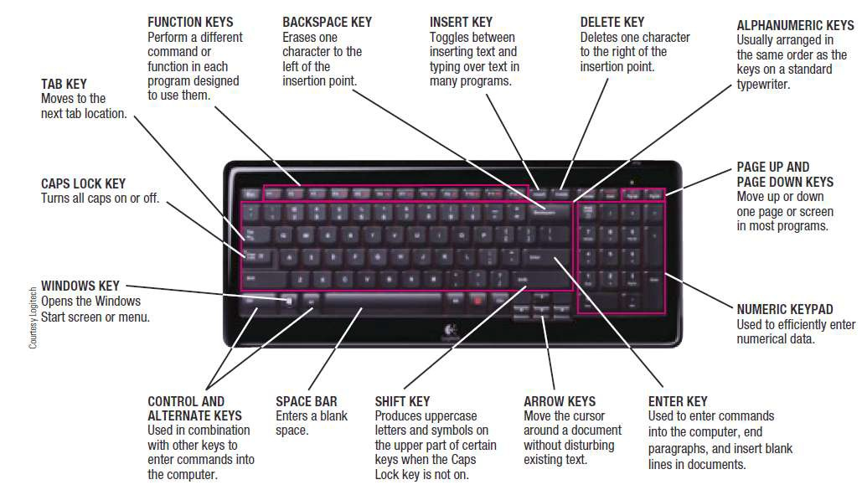

Keyboards

Slide 7
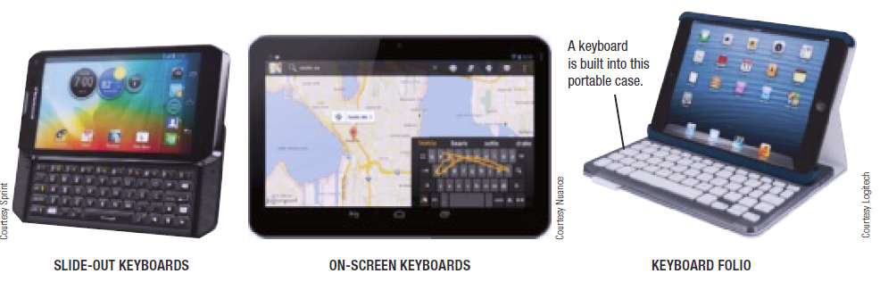

Keyboards
Mobile devices often use:
  Slide-out keyboard
  Pen or touch input (on-screen keyboard)
  Keyboard dock

Slide 8
Pointing and Touch Devices
Pointing devices are used to:
  Select and manipulate objects
  Input data
  Issue commands to the computer
Common types of pointing devices:
  Mouse
  Pen/stylus
  Devices that use touch input

Slide 9
Mice
Mouse
  Common pointing device that the user slides along a flat surface to move a pointer around the screen and clicks its buttons to make selections
  Older mechanical mice use a ball
  Optical or laser mice track with light
  Touch mice support two-dimensional gestures

Slide 10
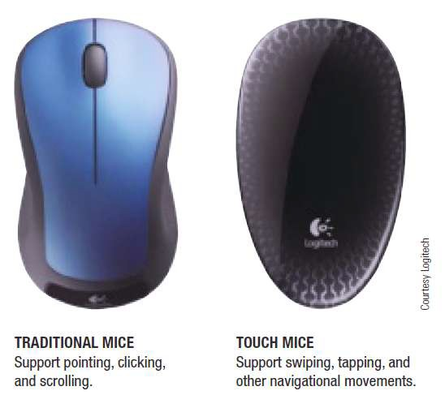
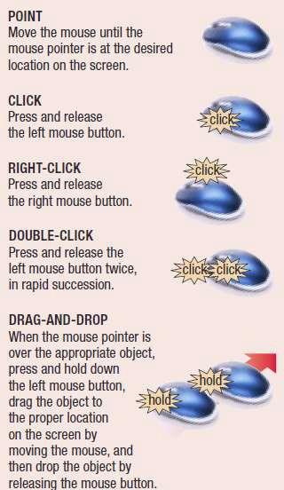
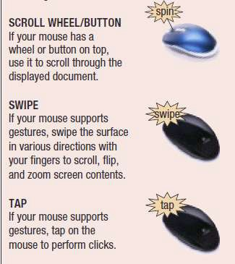


Mice
10

Slide 11
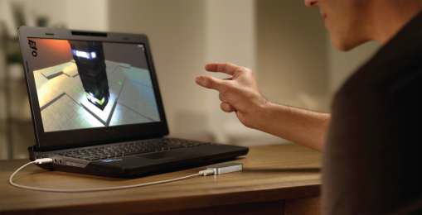
Trend Box
Perceptual Computing
Users control devices with 3D gestures, voice commands,
and facial expressions
Noncontact system
Allows for full body input and input from a slight distance
away

Slide 12
Pens/Styluses
Stylus
  Pen-like device used to draw or write electronically on the
screen
  Also called digital pen, electronic pen, tablet pen
  Pen input is being used for:
    Photography, graphic design, animation
    Industrial design, document processing, and healthcare applications
    Navigating through a document
    Issuing commands

Slide 13
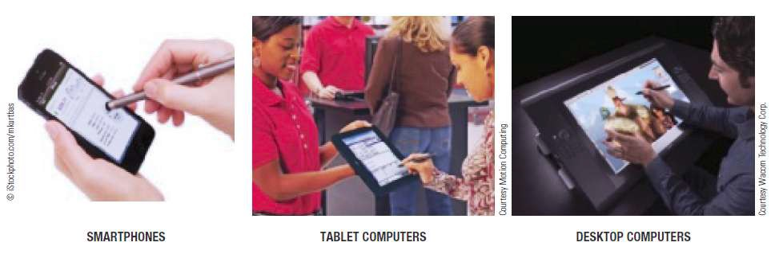

Pens/Styluses
Pen-Based Computers and Mobile Devices
  Pen input used with mobile devices and tablet computers
    Used to input handwritten text and sketches and to
manipulate objects
    If handwriting recognition is used, written text can be
converted to editable typed text

Slide 14
Pens/Styluses
Digital Writing Systems
  Pen-based systems that capture handwritten input as it is
being written
  Requires special paper with a grid of dots
  Handwritten input can be transferred to computer
Graphics Tablets
  Pen tablets or digitizing devices
  Flat, touch sensitive tablet typically connected to
computer using a USB port

Slide 15
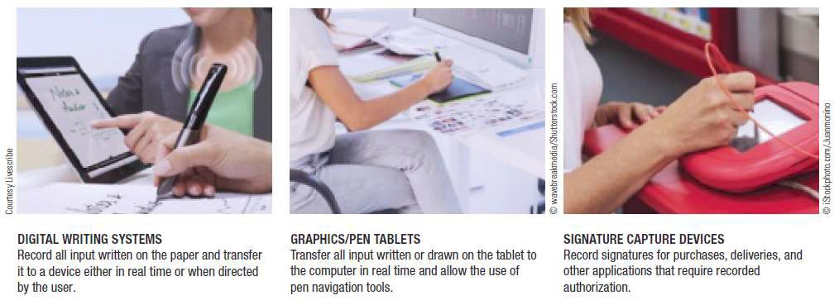

Pens/Styluses
Signature Capture Devices
– Found at check out counters to record customer signatures

Slide 16
Touch Screens
Touch Screens
  Display devices that are touched with the finger to select
commands or otherwise provide input to the computer
  Common on portable computers, smartphones, and other mobile devices
  Multi-touch
    Can recognize input from more than one finger at a time
  Table PC
    Large screen computer either built into a table or designed to be used on a table

Slide 17
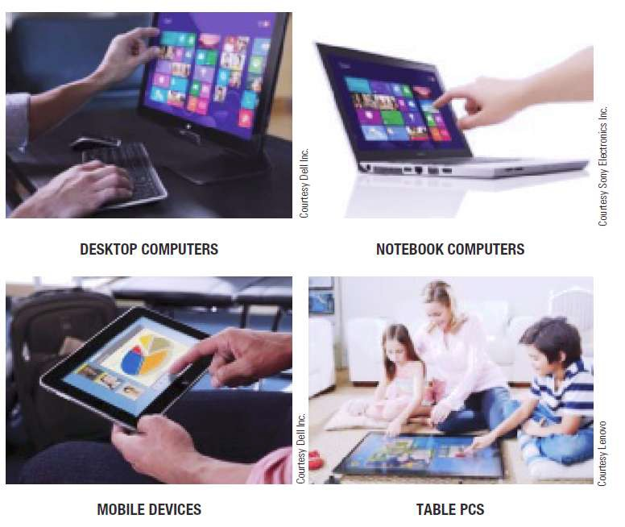

Touch Screens

Slide 18
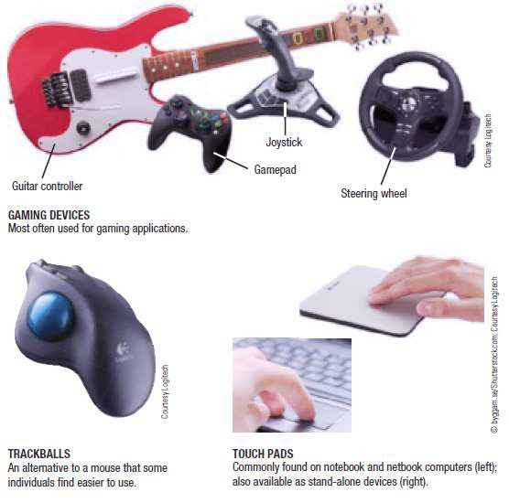

Other Pointing Devices
Gaming devices
Trackballs
Control buttons and
wheels
Touch pads

Slide 19
Quick Quiz
An optical mouse is .
  the same as a wireless mouse
  a mouse that tracks movements with light instead of a ball
  a mouse that contains a scroll wheel on the top
True or False: With handwriting recognition, text is input as a
graphical image so the text cannot later be edited as text.
An input device that looks like an upside-down mouse with the ball on top is a(n) .
Answers:
1) b; 2) False; 3) trackball

Slide 20
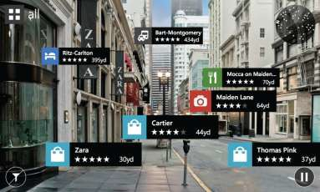
How It Works Box
Augmented Reality
Computer generated images are overlaid on top of real-
time images
Today, most often with smartphones using camera input, location info, and other data
Displays appropriate information related to images
captured by the smartphone
20

Slide 21

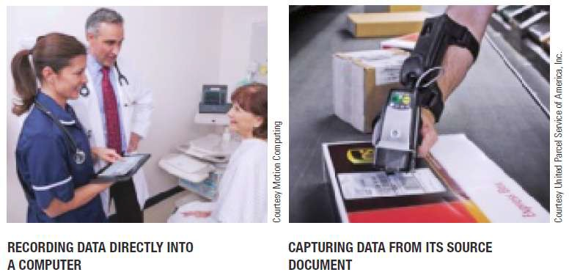
Scanners, Readers, and Digital Cameras
Source documents
  Already exists in physical form (photographs, checks, or
product label)
Source data automation
  Captures data directly from a source
document
    Saves time
    Increases accuracy
    Utilizes scanning or
reading devices

Slide 22
Scanners
Scanners (Optical Scanners)
  Input devices that read printed text and graphics and
transfers them to a computer in digital form
  Data is typically input as a single image
  Can scan photos, documents, images
  Types of scanners
    Flatbed
    Portable
    3D
    Receipt and business card scanners

Slide 23

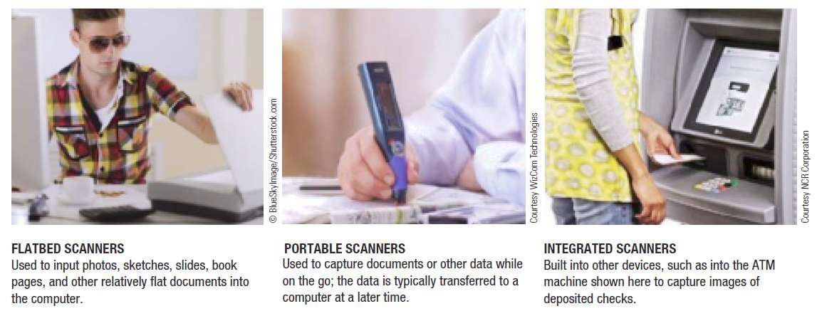
Scanners

Slide 24

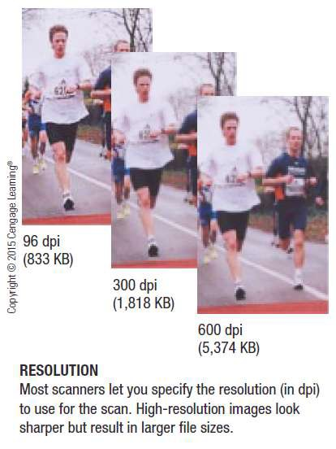
Scanners
Scanning Quality and Resolution
  Quality of scanned images
indicated by optical resolution
    Measured in number of dots per inch (dpi)
    Can often be specified when
image is scanned
    Can be changed when
scanned image is edited
  Higher resolution means better quality but larger file size

Slide 25
Readers
Barcode Readers
  Input devices that read barcodes
Barcodes
  Machine-readable codes that represent data as a set of bars
  Common Types
    Universal Product Code (UPC)
    ISBN
    DataBar
    QR Codes

Slide 26
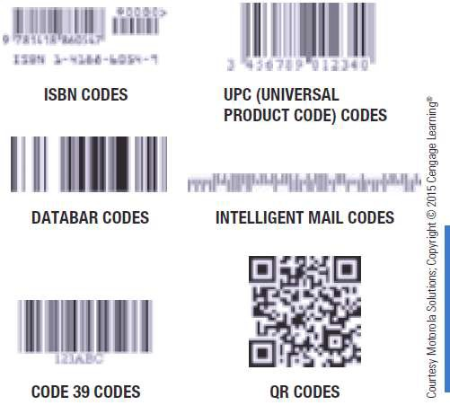

Readers

Slide 27

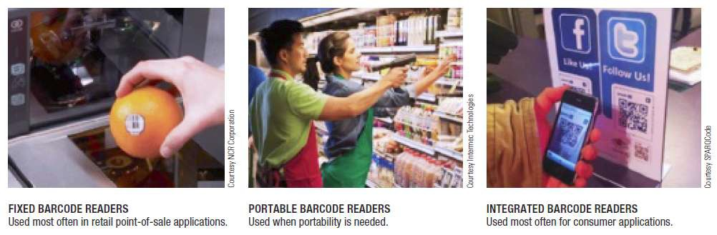
Readers

Slide 28

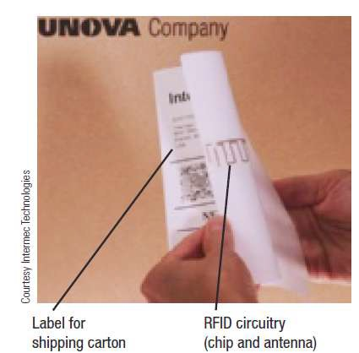
Readers
Radio Frequency Identification (RFID) Readers
  Technology used to store and
transmit data located in RFID tags
  RFID tags contain tiny chips and
radio antennas
    Can be attached to objects
    Read by RFID readers
    Tags only need to be within range of the reader, rather than in the line of sight

Slide 29
Readers
Applications
  Tracking inventory and assets
  Electronic toll collection
  Tracking patients in hospitals
  Ticketing applications
  Speeding up ID process of travelers at border crossings
Types of RFID Readers
  Handheld, portal, and stationary
Slow to catch on in retail industry due to privacy and security issues

Slide 30
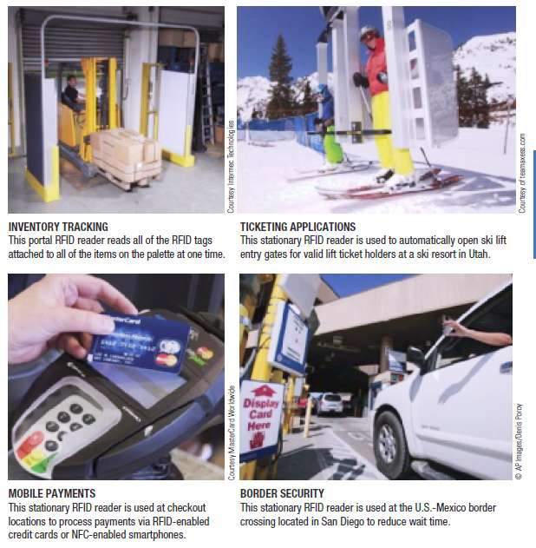

Readers
30

Slide 31
Readers
Optical Mark Readers (OMRs)
  Input data from special forms to score or tally exams,
questionnaires, ballots
Optical Character Recognition (OCR) Devices
  OCR is the ability of a computer to recognize scanned text characters and convert them to electronic form as text, not images
  OCR software is used to identify each character and
convert it to editable text
  Used to process turnaround documents like monthly bills

Slide 32
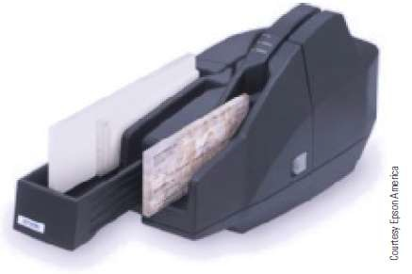
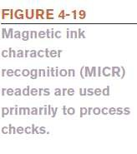
Readers
Magnetic Ink Character Recognition (MICR) Readers
  Also called check scanners
  Used primarily for banking
  Read the special magnetic characters printed at the bottom of checks
  High volume readers process deposited checks
  Used to facilitate remote deposits and electronic check processing

Slide 33
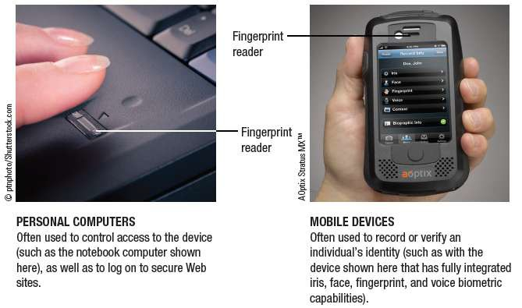

Readers
Biometric Readers
  Used to input biometric data such as an individual’s
fingerprint or voice
  Can be stand-alone or built into another piece of hardware
  Most often used for access control, to authorize electronic payments, log on to secure Web sites

Slide 34
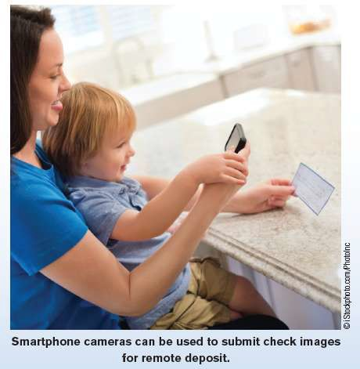
Technology and You Box
Mobile Deposits
Mobile remote deposit
capture
Transmit check information via smartphone app and camera
App optimizes the check front and back images and transmits images and deposit data to your bank

Slide 35
Digital Cameras
Digital Cameras
  Take pictures and records them as digital images
  Can either be still cameras or video cameras
  Integrated into many portable computers and mobile phones
Digital Still Cameras
  Primary appeal is that images are immediately available
  Camera quality is measured in megapixels
  Typically use flash memory for storage
  Camera phones can be used to read barcodes, remotely deposit checks, etc.

Slide 36
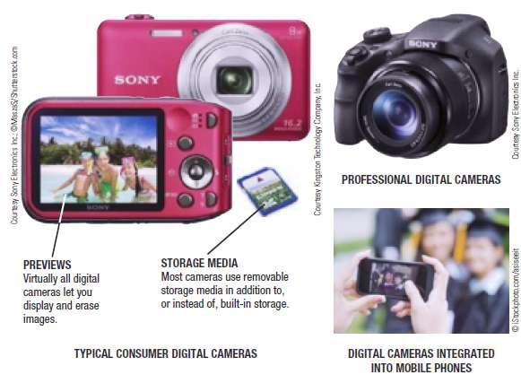

Digital Cameras

Slide 37
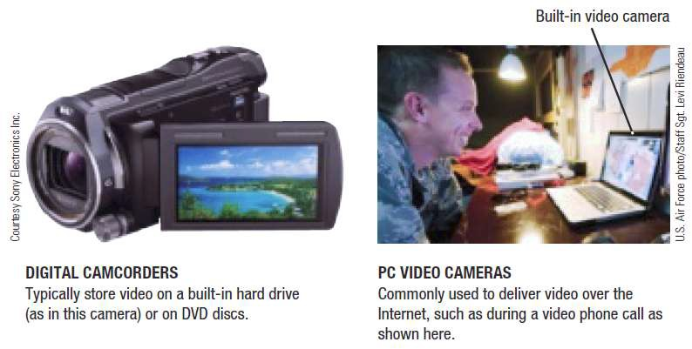

Digital Cameras
Digital Video Cameras
  Digital camcorders, PC video cameras (PC cams, webcams)
  Built-in or stand alone
  Store images on digital media (flash memory, DVDs, hard drives, etc.)
Applications
  Surveillance video cameras
  Video conferences and Webinars
  Face recognition systems

Slide 38
Audio Input
Voice Input and Speech Recognition Systems
  Audio Input
    The process of entering audio data into the computer
  Voice Input
    Inputting spoken words and converting them to digital
form via microphone or headset
    Can be used for podcasts and with VoIP (Voice over IP) systems
    Provides spoken instructions to computer when used
with speech recognition systems

Slide 39
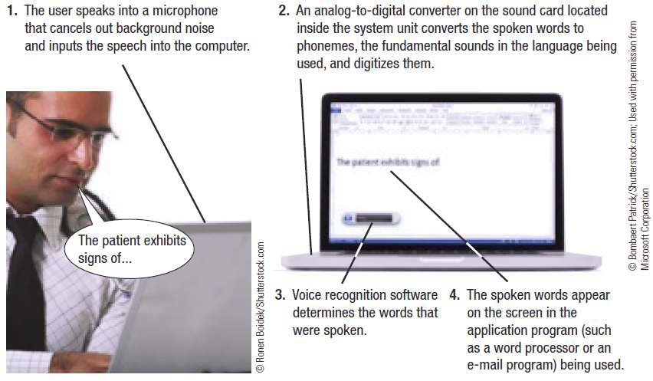

Audio Input

Slide 40
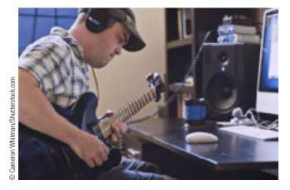
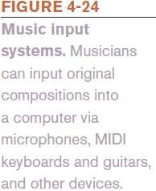
Audio Input
Music Input Systems
  Used to input music
    Existing music can be input
using CDs or a Web download
    For original compositions, microphones, keyboard controllers, and guitar controllers can be used to input music
40

Slide 41
Quick Quiz
Which of the following is used in conjunction with Scantron test forms, voting ballots, and other documents in which the selection is bubbled in?
  OCR
  MICR
  OMR
True or False: Flatbed scanners can be used to scan photos, as well
as documents on conventional paper.
A voice input system requires software and a(n) in order to input voice data or commands into a computer.
Answers:
1) c; 2) True; 3) microphone

Slide 42
Display Devices
Display Device
  Presents output visually on some type of screen
  Monitor
    Display device for a desktop computer
  Display Screen
    Screen built into a variety of devices
      Notebook and other portable computers
      Mobile phones and mobile devices
      Handheld gaming devices, home entertainment devices, kitchen appliances
      Digital photo frames, e-book readers, smart watches
      Digital signage systems, digital billboards

Slide 43
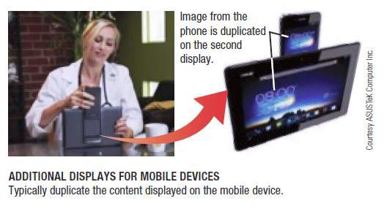
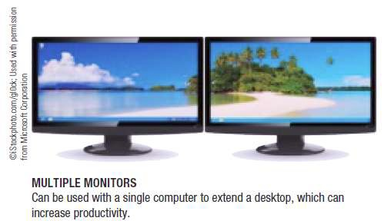

Display Devices
Display Device Characteristics
  Color vs. Monochrome Displays
    Images are formed using
pixels
    Most displays today are color displays
  CRT vs. Flat-Panel Displays
    Cathode ray tube (CRT) displays: large, bulky, and heavy
    Flat-panel displays: take up less desk space; use less power

Slide 44
Display Devices
Size and Aspect Ratio
  Device size measured diagonally from corner to corner
Screen Resolution
  Number of pixels used on a display determines resolution
  Affects the amount of information that can be displayed
on the screen at one time
  Can be changed to match users’ preference

Slide 45
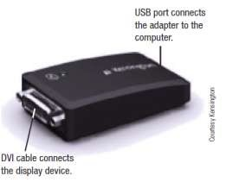

Display Devices
Video Adapters, Interfaces, and Ports
  Video cards determine the graphic capabilities of a
computer
  VGA, DVI, and HDMI are the three most common interfaces to connect monitors to a computer
  Ports exposed in the system unit cases are to connect
monitors to computers
    New option is to use USB
ports

Slide 46
Display Devices
Wired vs. Wireless Displays
  Wired display are physically connected to the system via a
cable
  Wireless displays connect using a wireless network connection (Wi-Fi, Bluetooth)
2D vs. 3D Displays
  Most displays are 2D
  3D displays use filters, prisms, and multiple lenses to
create the 3D effects

Slide 47
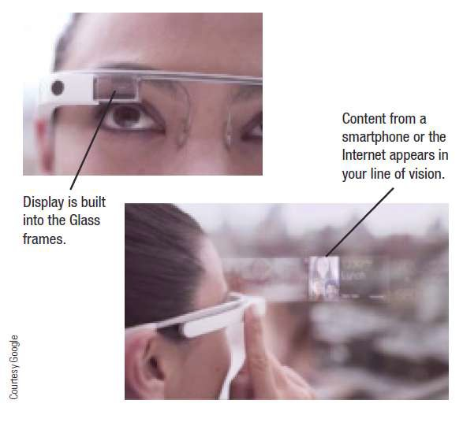

Display Devices
Wearable Displays
  Project images from a mobile device to a display screen built into glasses
Touch and Gesture Capabilities
  Kiosks and portable gaming
devices
  Mobile phones and media
tablets

Slide 48
Flat Panel Display Technologies
Liquid Crystal Displays (LCDs)
  Use charged liquid crystals between sheets of glass or
plastic
  Requires backlighting
Light Emitting Diode (LED) Displays
  Used in alarm clocks and Christmas lights
  Currently used to backlight LCD panels

Slide 49
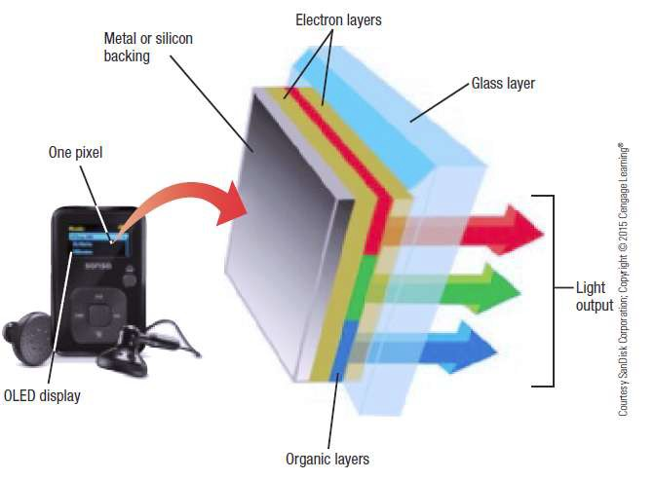
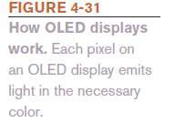
Flat Panel Display Technologies
Organic Light Emitting Diode (OLED) Displays
  Use layers of organic material
  Emit visible light when current is applied
  Are thinner than LCDs
  Have a wider viewing angle
  Incorporated into many digital cameras, mobile phones, and portable digital media players

Slide 50
Flat Panel Display Technologies
Special Types of OLEDs
  FOLED (Flexible OLED)
    OLED displays built on flexible surfaces such as plastic
or metallic foil
  TOLED (Transparent OLED)
    Displays are transparent
    Emit light toward top and bottom of display surface
  PHOLED (Phosphorescent OLED)
    Process that results in much more conversion of
electrical energy into light instead of heat
50

Slide 51
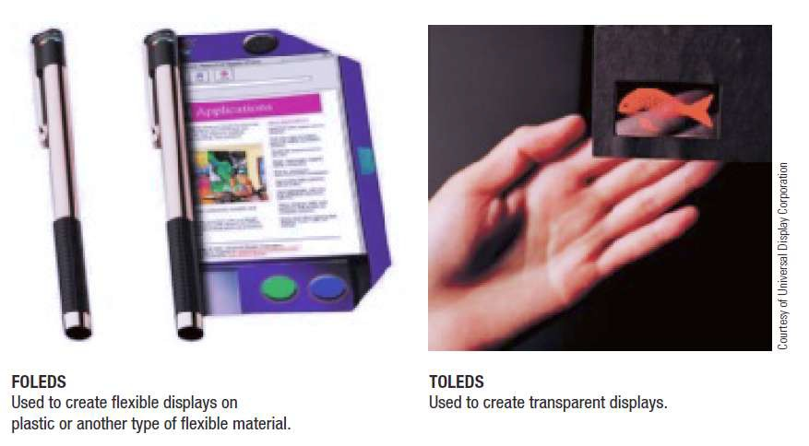

Flat Panel Display Technologies

Slide 52
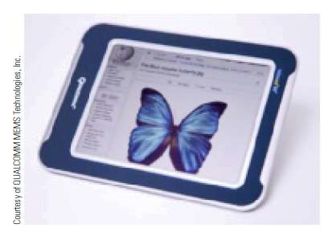
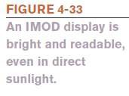
Flat Panel Display Technologies
Interferometric Modulator (IMOD) Displays
  Essentially a complex mirror that
uses external light to display images
  Designed initially for mobile phones
and portable devices
  Images are bright and clear, even in sunlight
Plasma Displays
  Use layers of gas between two plates of glass
  Being replaced by LCDs

Slide 53
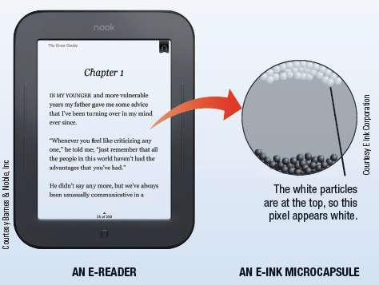
Inside the Industry Box
E-Paper
Used for e-readers and other devices
Easier to read in direct sunlight
Content can change wireless
Only uses power to change images, not maintain an image
Use electronic ink
Monochrome or color

Slide 54
Data and Multimedia Projectors
Display output from a computer to a wall or projection screen
Found in classrooms and conference rooms
Can be wireless or integrated into devices
Some contain an iPod dock
Pico projectors are pocket-size and connect mobile and
portable devices
Hologram projectors used to display 3D images
3D projectors are designed to project 3D images that are
viewed with 3D glasses

Slide 55
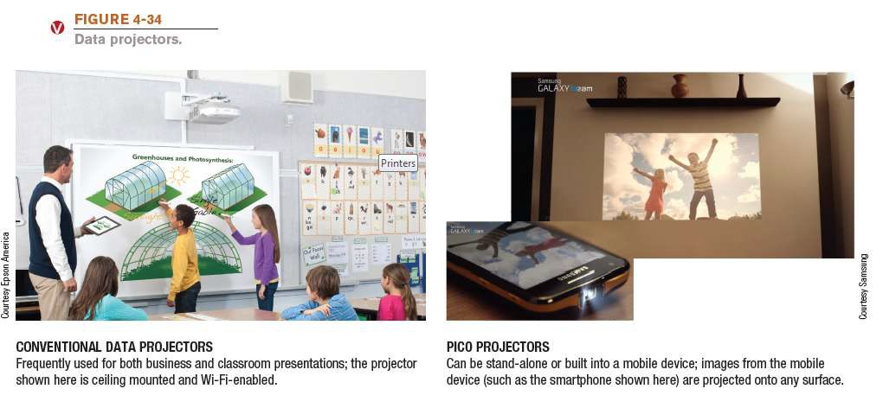
Data and Multimedia Projectors

Slide 56
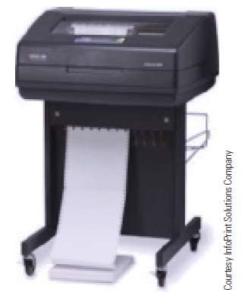
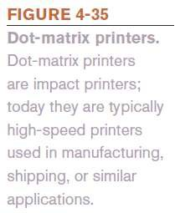
Printers
Printing Technology
  Impact Printers (Dot Matrix)
    Print mechanism strikes an inked
ribbon to transfer ink to the paper
    Used to produce multipart forms
  Non-Impact Printers (Ink-Jet/Laser)
    Use liquid ink or toner
    Produce higher quality images
    Much quieter than impact printers

Slide 57
Printers
Color vs. Black and White
  Colors printers use magenta, cyan, yellow, and black ink
Print Resolution
  Measured in dpi (dots per inch)
  More dots per inch results in higher quality output
  300 dpi for general purpose printing; 1,200 dpi for
photographs; 2,400 dpi for professional applications
Print Speed
  Measured in pages per minute (PPM)
  Range from about 15 to 65 ppm

Slide 58
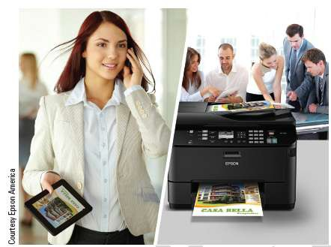
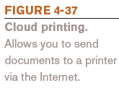
Printers
Personal vs. Network Printers
  Personal printers connect directly to a single computer
  Network printers connect directly to a home or an office
network; some can perform cloud printing
  Connection Options
    USB connection most com
Multifunction Capabilities
  Copy, fax, scan, print
  All-in-ones
mon

Slide 59
Laser Printers
Use toner powder and technology similar to that of a photocopier to produce images on paper
The standard for business documents
Print one entire page at a time
Generally faster and have better quality output than ink-jet
printers
Can be black and white or color
Common print resolution for laser printers is between 600
and 2,400 dpi
Use toner cartridges

Slide 60
Ink-Jet Printers
Sprays droplets of ink to produce images on paper
Use ink cartridges
Usually print in color
Often the choice for home use
Relatively inexpensive with good-quality output
Print more slowly than laser printers
Potential applications for the future
– Dispensing liquid metal, aromas, computer chips and other circuitry, “printing” human tissue
60

Slide 61
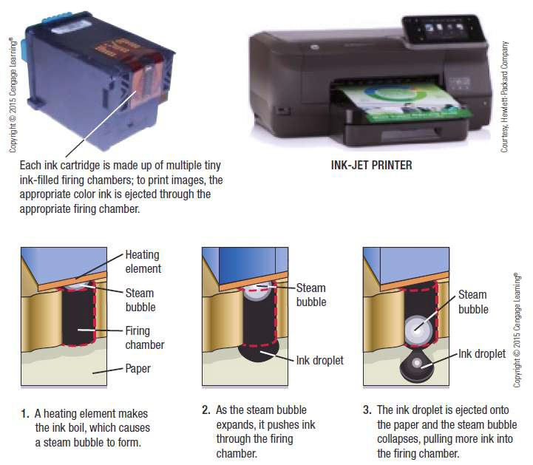

Ink-Jet Printers

Slide 62
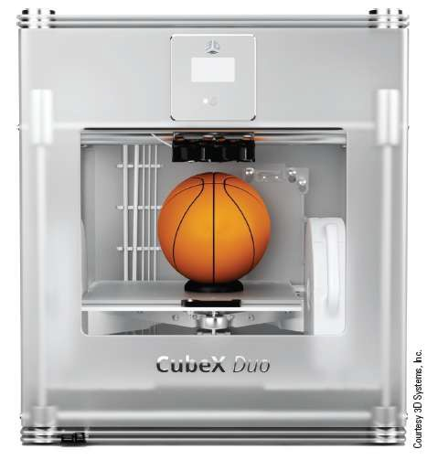
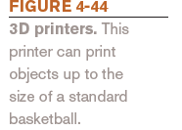
Special Purpose Printers
Barcode, label, and postage printers
Photo printers
Portable and integrated printers
Wide-format ink-jet printers
3D printers

Slide 63
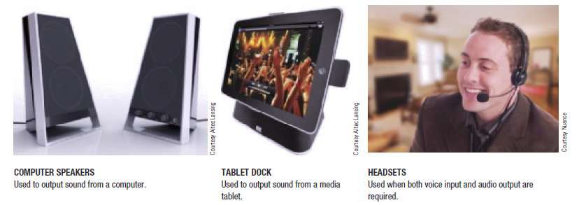

Audio Output
Audio Output
  Voice, music, and other audible sounds
  Common audio output devices
    Computer speakers
    Headphones and headsets
    Earphones and earbuds

Slide 64
Quick Quiz
Which of the following types of display devices should have the largest footprint (the amount of room taken up on a desk)?
  CRT monitor
  OLED display
  LCD display
True or False: Laser printers can only print in black and white.
printers form images with drops of liquid ink.
Answers:
1) a; 2) False; 3) Ink-jet printers

Slide 65
Summary
Keyboards
Pointing and Touch Devices
Scanners, Readers, and Digital Cameras
Audio Input
Display Devices
Printers
Audio Output

